Slide 1

Project Title – Netflix Dataset Analysis
Md Tarik Anvar
APPLY_175605418868ab42ac82f7c

Slide 2

PROBLEM STATEMENT
Major Project Proposal: Netflix Dataset Analysis
1. Introduction to Dataset
The dataset under consideration is a Netflix dataset containing 7,789 records and 11 columns. It includes important details about Movies and TV Shows available on the platform. Key attributes include the title, director, cast, country of origin, release date, rating, duration, and type (genres). The dataset spans multiple years, with entries ranging from 2008 to 2021, covering content across diverse countries and genres.
2. Problem Statement
Netflix has become one of the most prominent global streaming platforms, continuously expanding its library with a mix of original productions and licensed content. However, with growing competition from platforms like Amazon Prime, Disney+, and regional OTT providers, Netflix must strategically analyze its content catalog to identify strengths, gaps, and opportunities.
The specific problem to be addressed in this project is 'Content Trends Analysis for Strategic Recommendations'. The aim is to uncover how Netflix’s content distribution (Movies vs. TV Shows, genres, and country contributions) has evolved over the years. This will enable the identification of key genres, audience preferences, and strategic insights into global content expansion.
3. Importance of the Problem Statement
Understanding Netflix’s content trends is crucial for making data-driven business decisions. The analysis not only highlights the balance between Movies and TV Shows but also reveals popular genres and underrepresented categories. For a platform that serves diverse international audiences, country-wise contributions provide valuable insights into global representation and market penetration.
By focusing on these content trends, Netflix can refine its strategy for content acquisition and production, ensuring that it caters to the right audience segments while staying competitive in the global OTT industry.
4. Objectives
- Analyze the distribution of Movies vs. TV Shows over the years. - Identify the most common genres and how their popularity has changed. - Compare country-wise contributions to Netflix’s catalog.
5. Expected Outcomes
- A clear understanding of how Netflix’s content strategy has evolved. - Identification of top-performing genres and categories. - Strategic recommendations on which content types Netflix should focus on in the future.

Slide 3
Project Description: Netflix Data Analysis
Our Goal:
To explore the Netflix dataset to understand its content strategy, identify key trends, and provide actionable recommendations for future growth.
Our Process:
Loaded & Inspected the Data:
We started by loading the dataset with 7,789 records and took a first look to understand its structure.
2.Cleaned the Data:
We prepared the data for analysis by:
Handling missing information for directors, cast, and countries.
Converting dates into a usable format to track when content was added.
Standardizing the Duration column, converting both movie runtimes and TV show seasons into a single unit (minutes).
3.Analyzed Key Trends:
Using plots and charts, we visualized the data to answer key questions about:
The balance between Movies and TV Shows.
The top countries and actors featured on the platform.
The most popular genres.
How the Netflix library has grown over the years.

Slide 4
Key Findings:
Movies Dominate:
The Netflix library contains more than double the number of movies compared to TV shows.
Rapid Content Growth:
Netflix significantly ramped up adding new titles after 2016, with a peak in 2019.
Focus on Mature Audiences:
A large portion of the content is rated TV-MA (for Mature Audiences) and TV-14, indicating a focus on adults and older teens.
US & India Lead Content:
The United States is the biggest contributor of content, followed closely by India, which is also reflected in the list of most frequent actors.
Popular Genres:
"International Movies," "Dramas," and "Comedies" are the most common genres, showing a focus on broad, global appeal.
Our Recommendations:
Invest More in TV Shows:
To improve subscriber retention, increase the volume of TV shows, especially in popular international and drama categories.
Target Family Audiences:
Create more family-friendly content (rated TV-G/PG) to better compete with platforms like Disney+.
Expand Local Productions:
Continue the successful strategy of producing local content in India and expand it to other promising markets like the UK and Japan.

Slide 5
WHO ARE THE END USERS?
Primary Users (Inside Netflix)
Content Strategy & Acquisition Team: These are the people who decide what movies and TV shows to buy or create. Our report helps them see which genres are popular, which countries are big markets, and where there might be gaps in the Netflix library.
Marketing Team: This team needs to know what’s popular to create effective advertising. Our analysis shows them which types of content and which actors resonate most, helping them target their campaigns to the right audience.
Executive Leadership (VPs, Directors): Top leaders need a clear picture of the company's direction. Our findings give them a quick, data-backed summary of Netflix's content trends, helping them plan for future growth and competition.
Secondary Users (Outside Netflix)
Competitors (like Disney+, Amazon Prime): Rival streaming services can use this analysis to understand Netflix's strategy and find areas where they can compete more effectively.
Production Studios & Creators: Filmmakers and TV producers can use our insights to understand what Netflix is looking for, helping them pitch projects that are more likely to be bought.
Media Journalists & Industry Analysts: Reporters who cover the entertainment industry can use this data to inform their articles and reports on the "streaming wars" and content trends.

Slide 6

Technology Used
Python: The core programming language that powered our entire analysis. It acted as the "engine" for everything we did.
Google Colab Notebook: Our interactive workspace. It allowed us to write code, see the results immediately, and add explanatory text and charts all in one place.
Pandas: The most important library for our data work. We used it for:
Loading the CSV file into a structured table (a DataFrame).
Cleaning messy data (like dates and missing values).
Filtering, sorting, and grouping data to find key information.
NumPy: A fundamental library for numerical operations in Python. We used it to set a "random seed" to ensure our analysis is reproducible.
Matplotlib & Seaborn: Our visualization toolkit. These two libraries worked together to create all the professional-looking plots and charts in our analysis, such as:
Bar charts (for Movies vs. TV Shows, Genres, Ratings).
Line charts (for content added over time).
Boxplots and Heatmaps.
Project Sharing Tools:
CSV format: To save our cleaned-up dataset for future use.

Slide 7
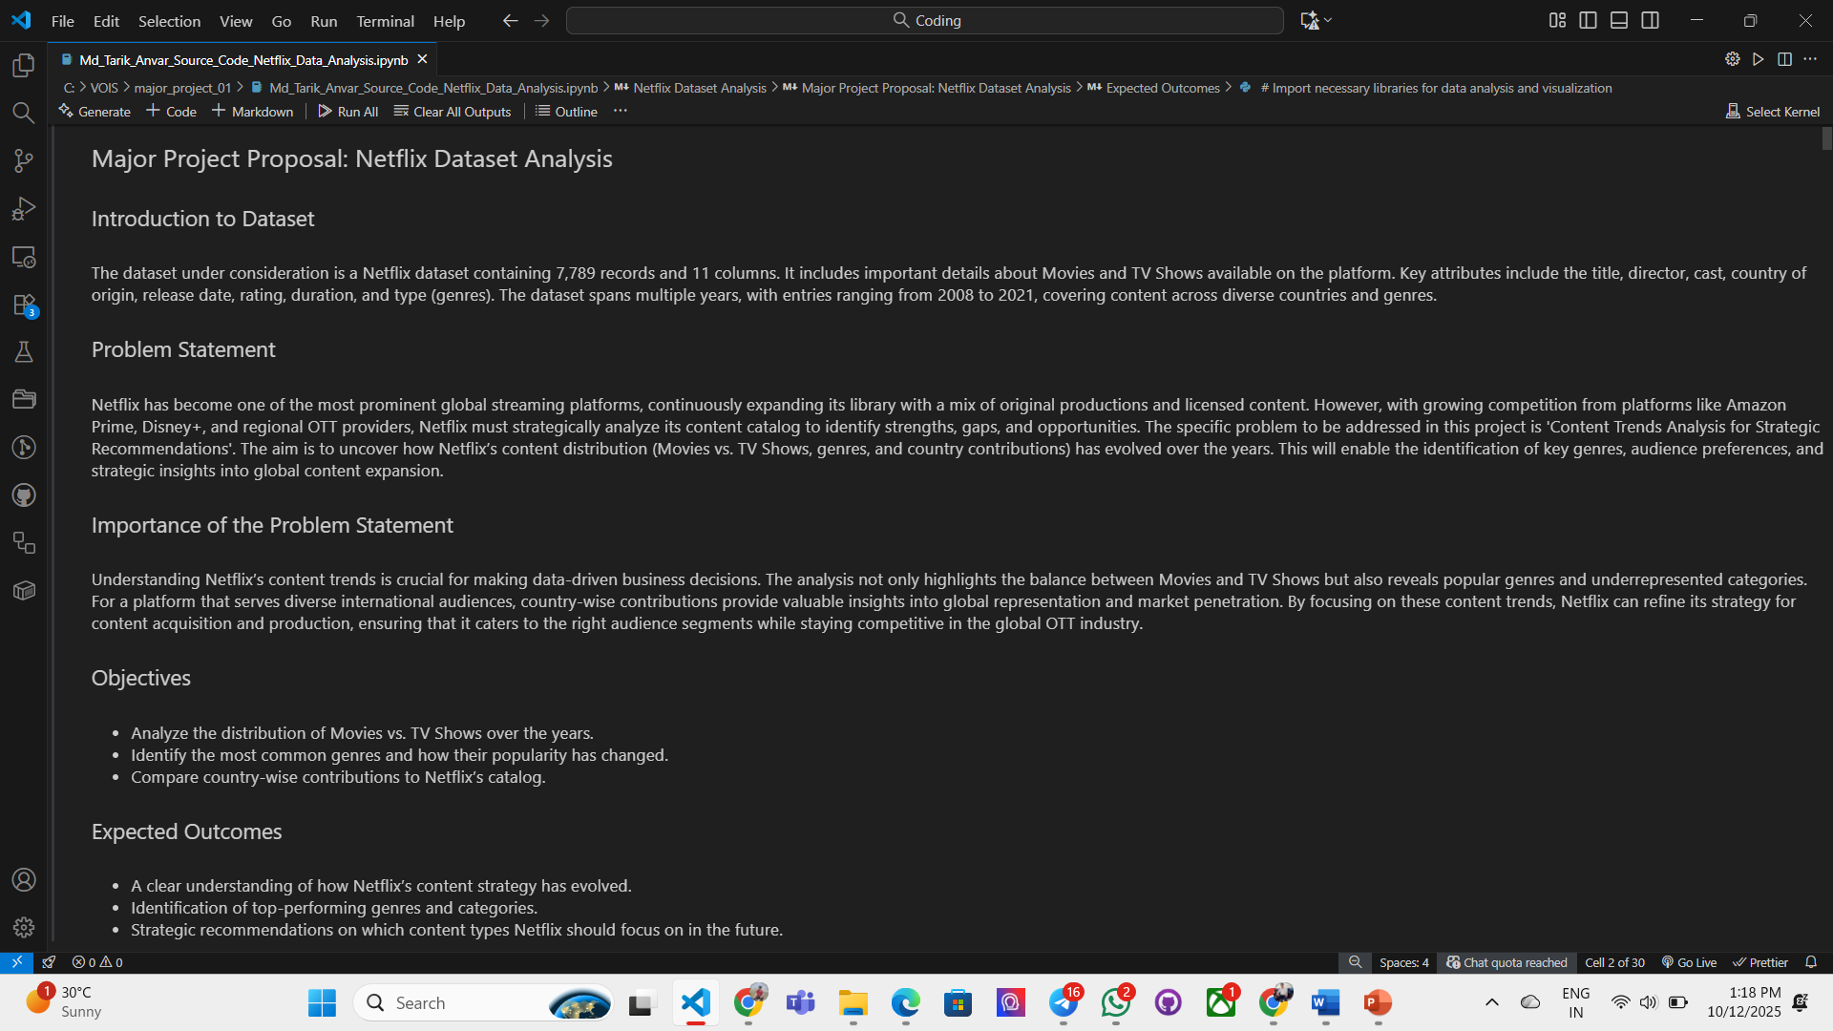
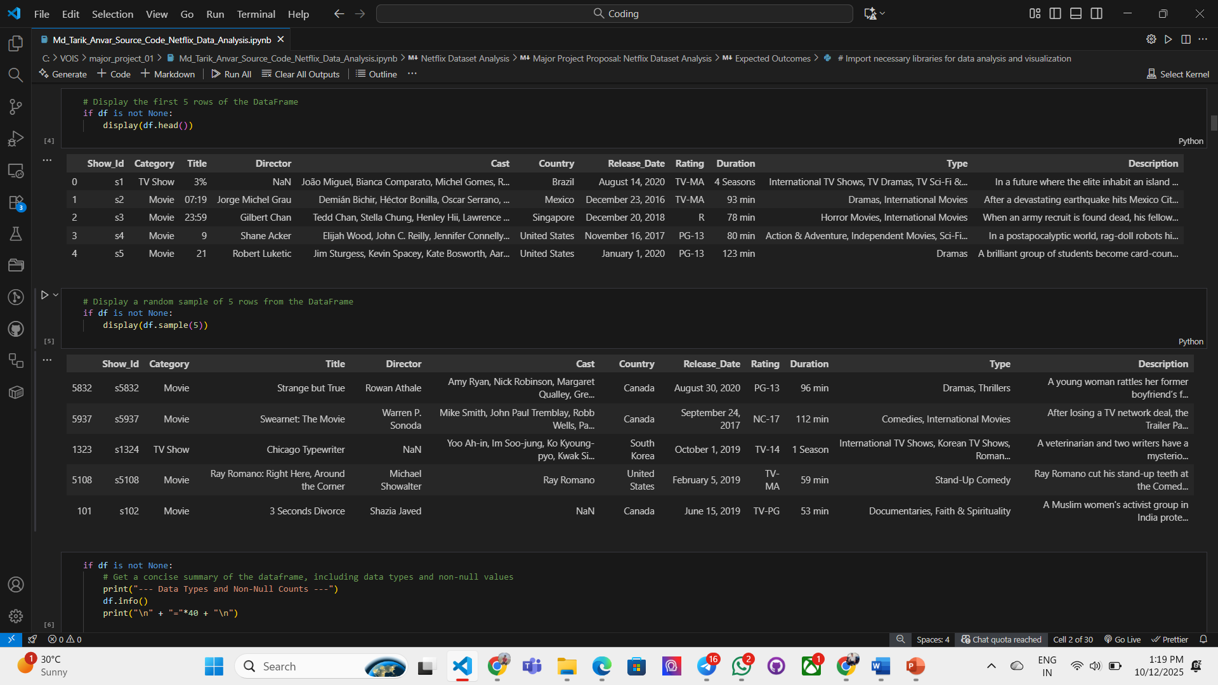
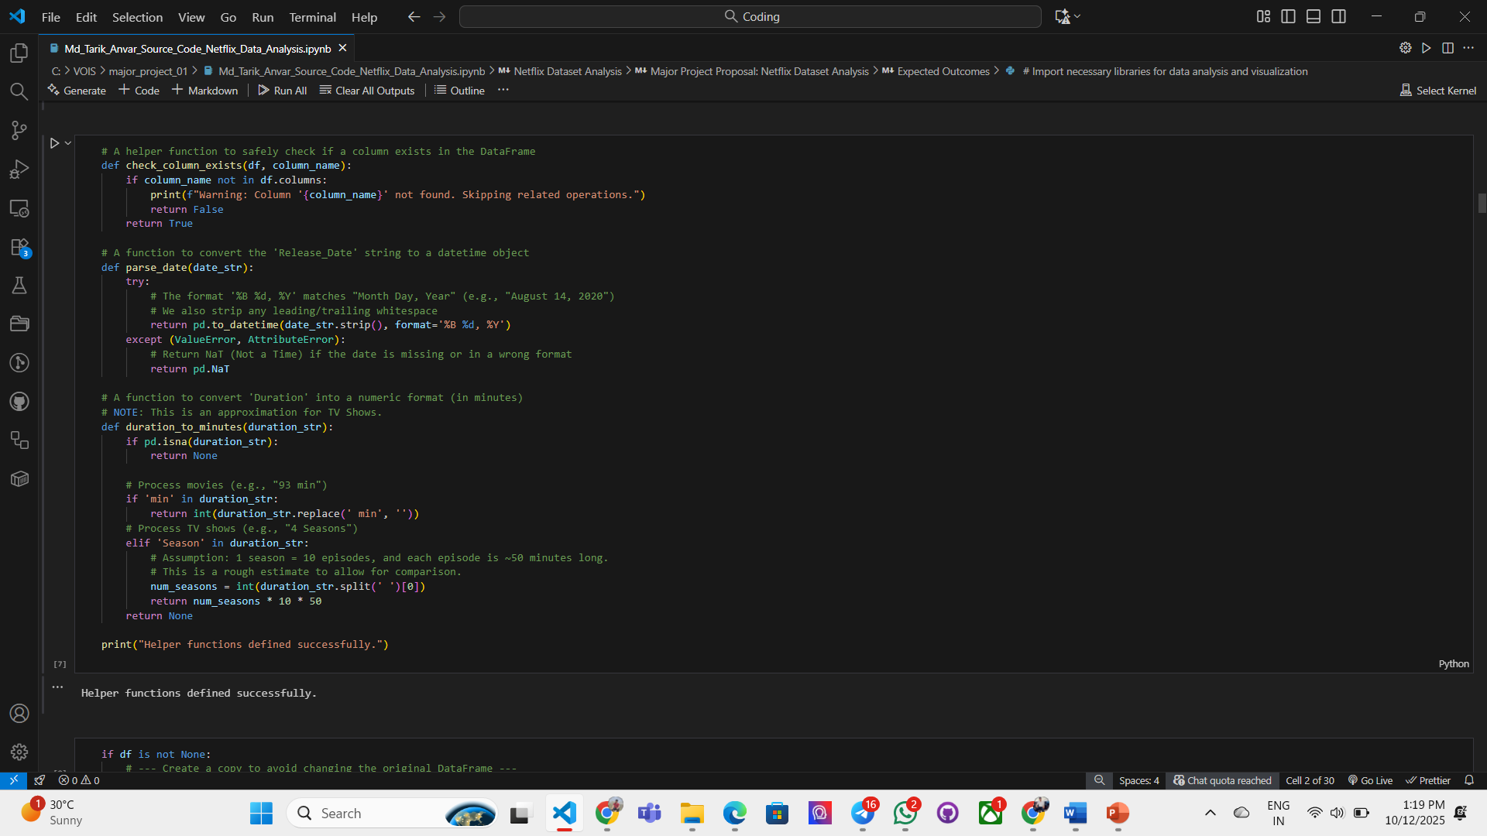
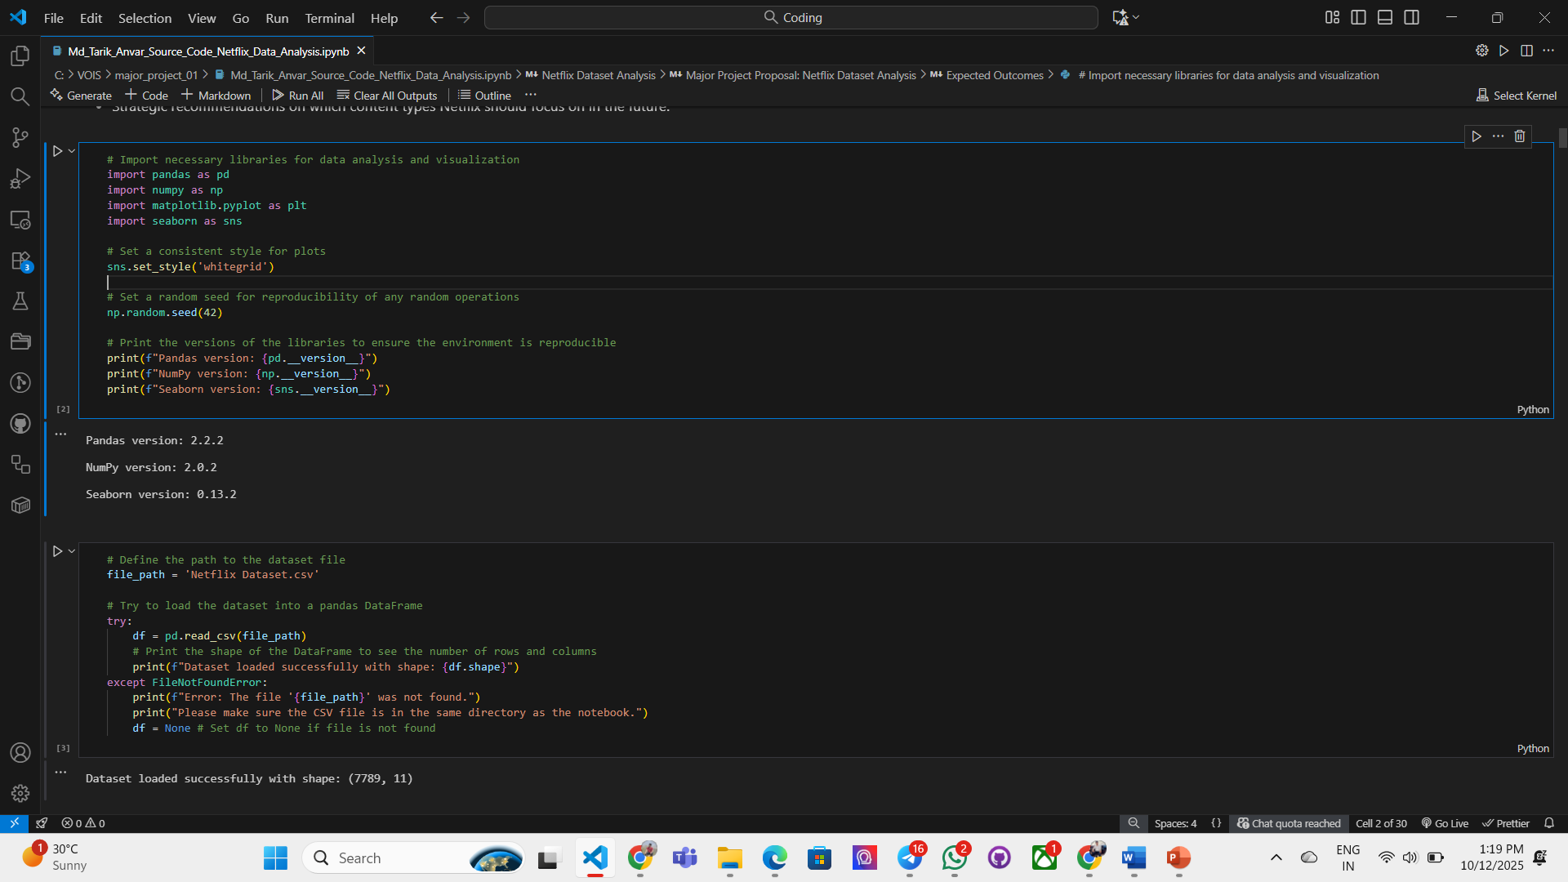
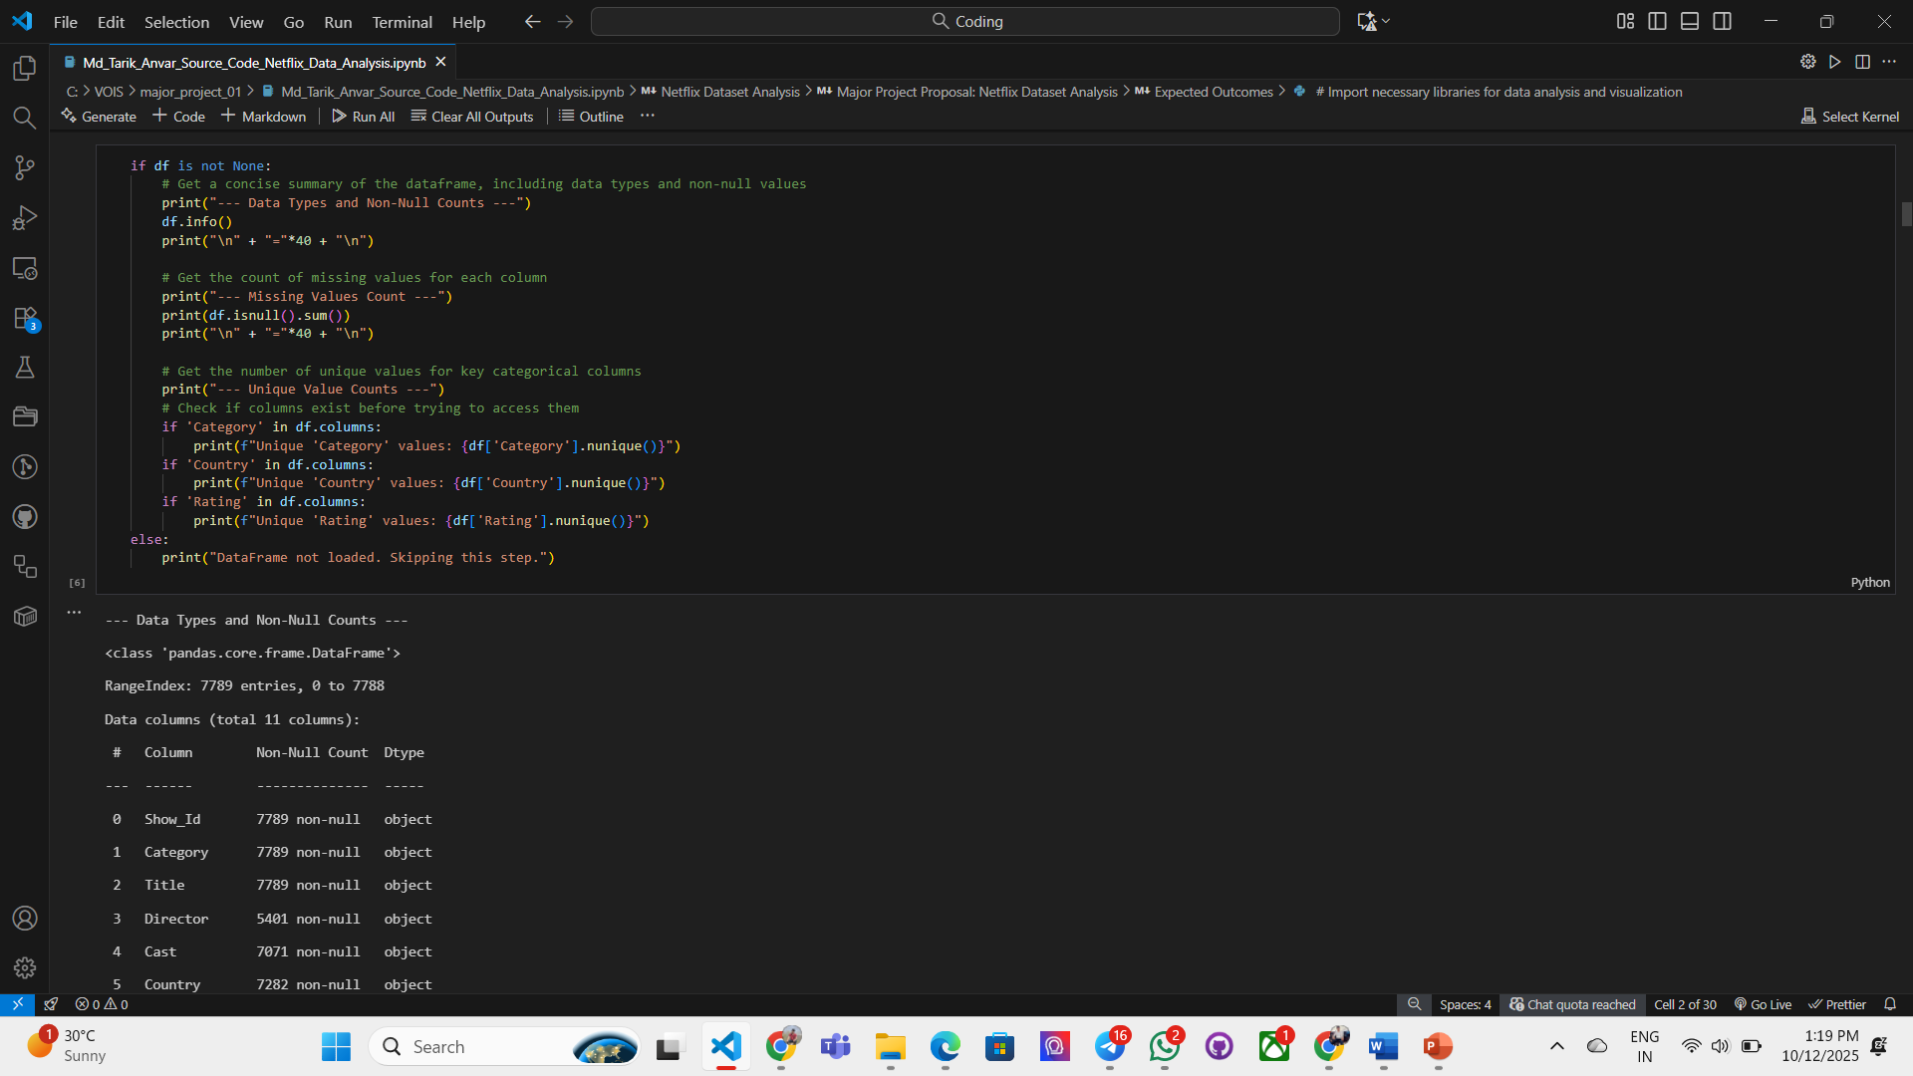
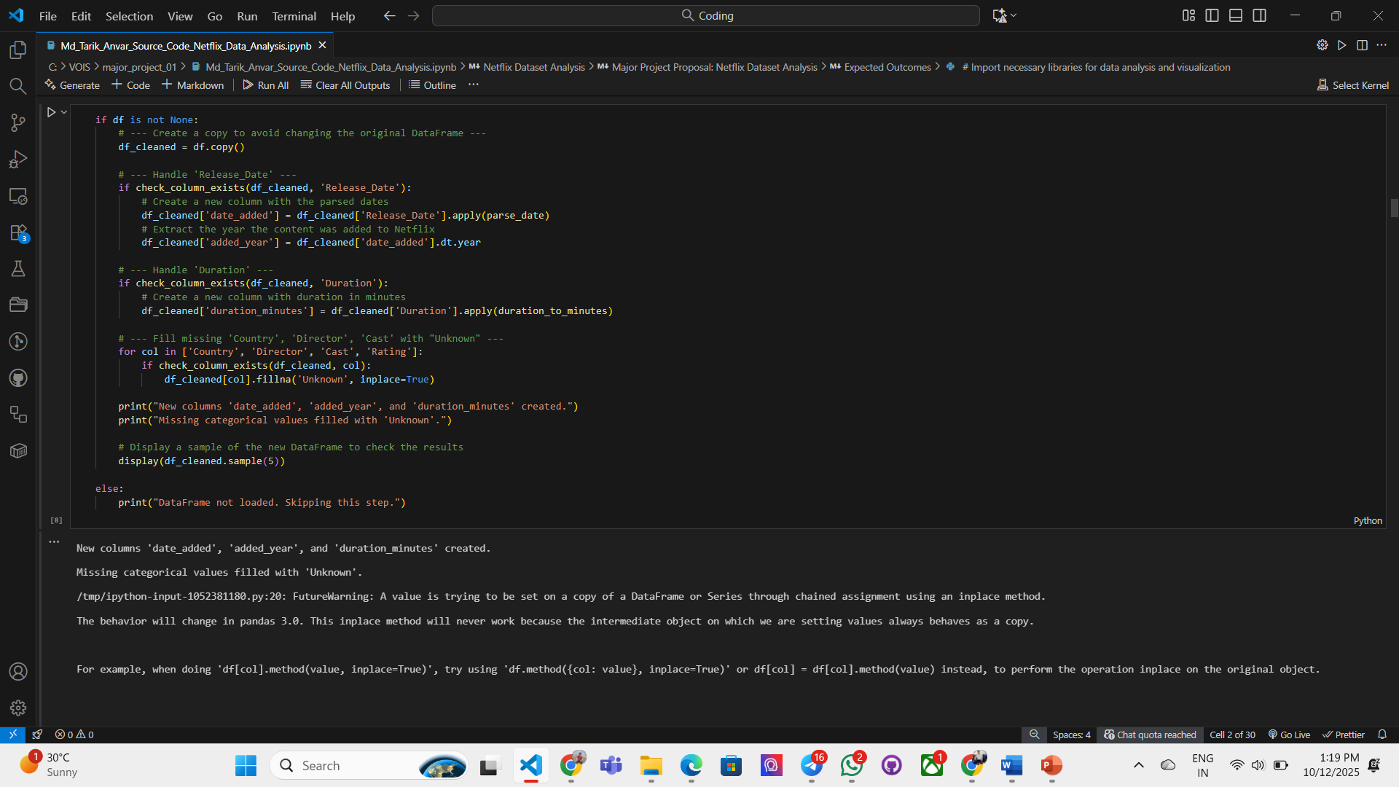
RESULTS1

Slide 8
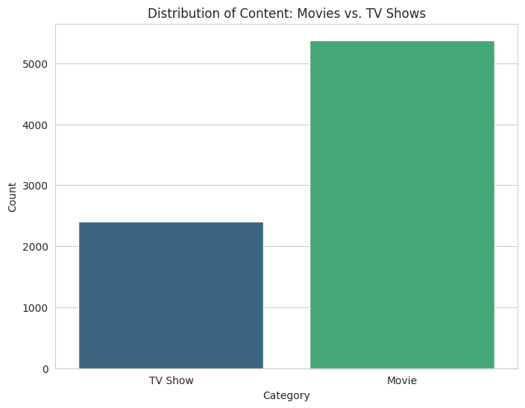
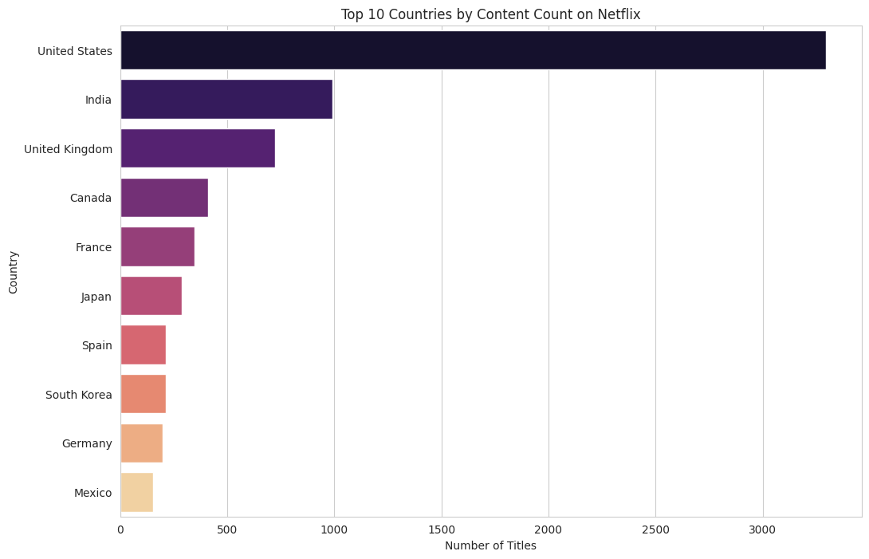
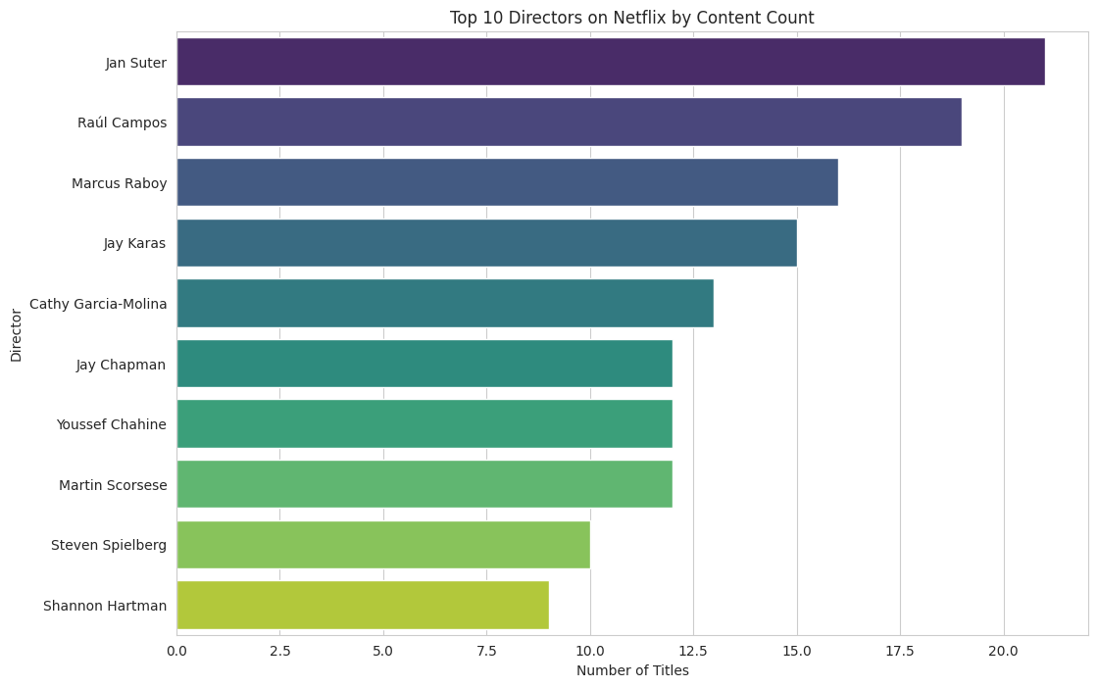
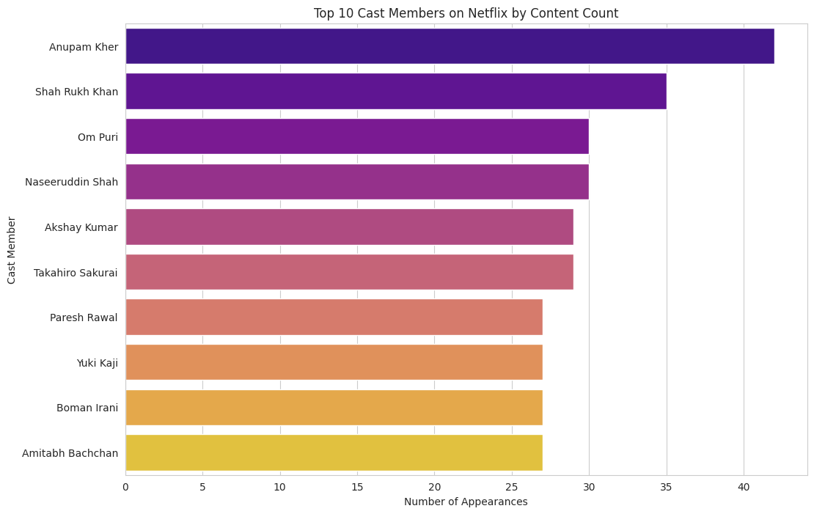
RESULTS2

Slide 9
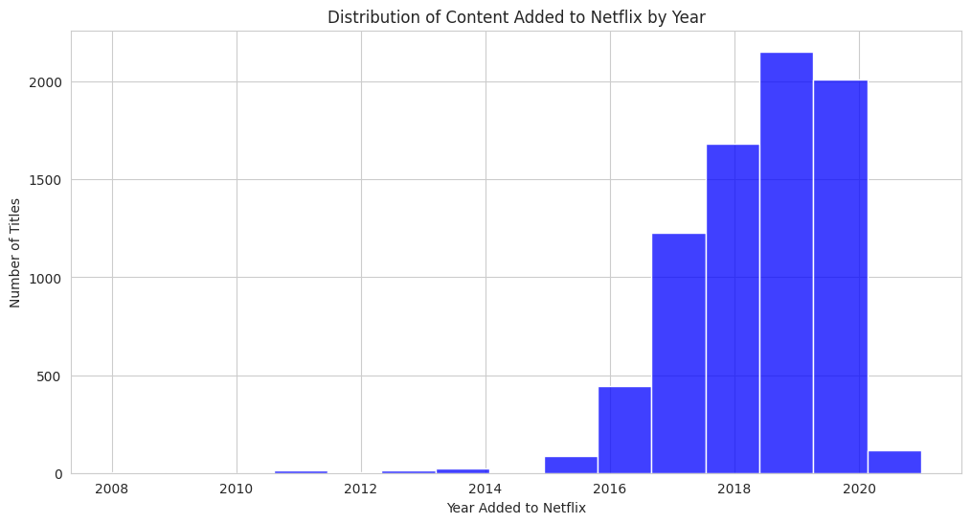
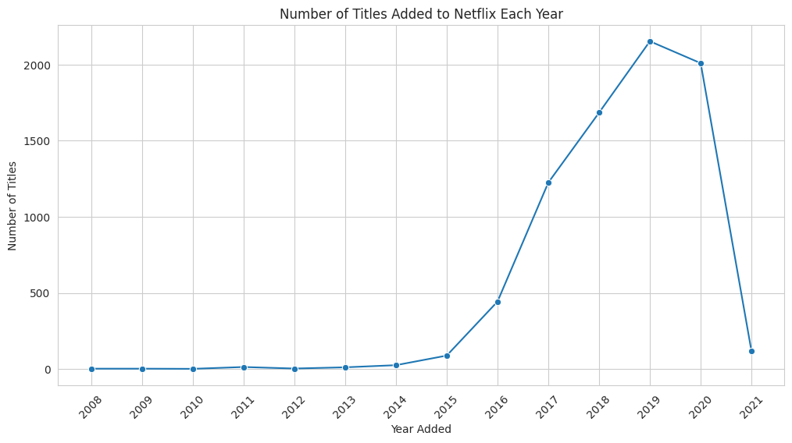
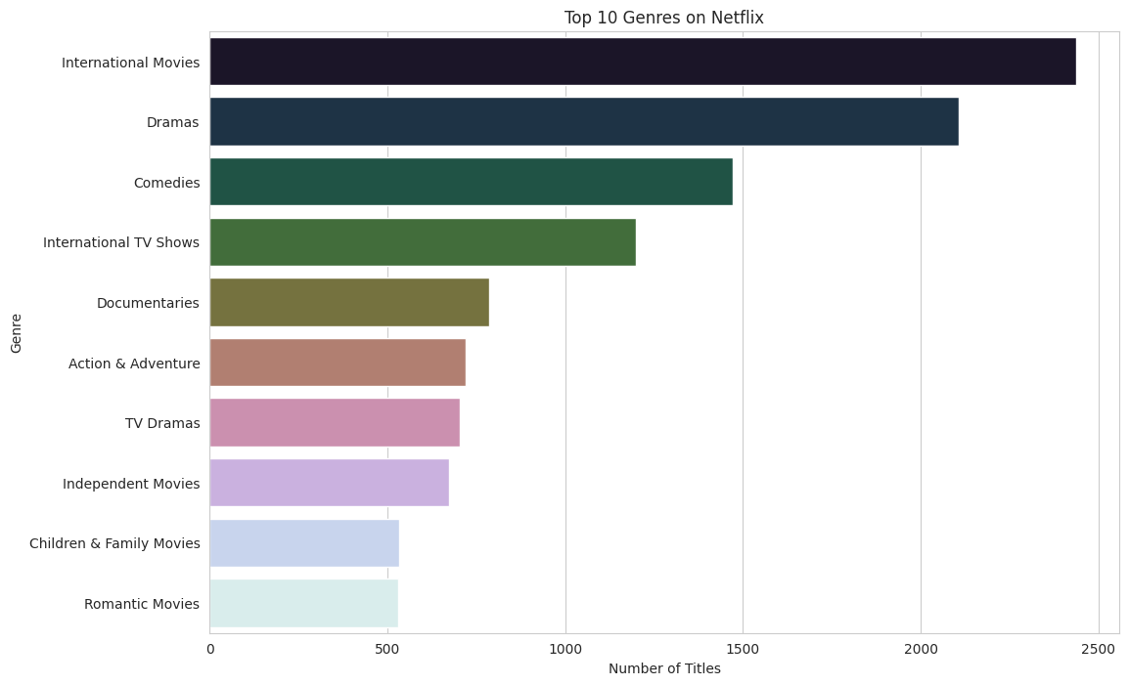
RESULTS3

Slide 10
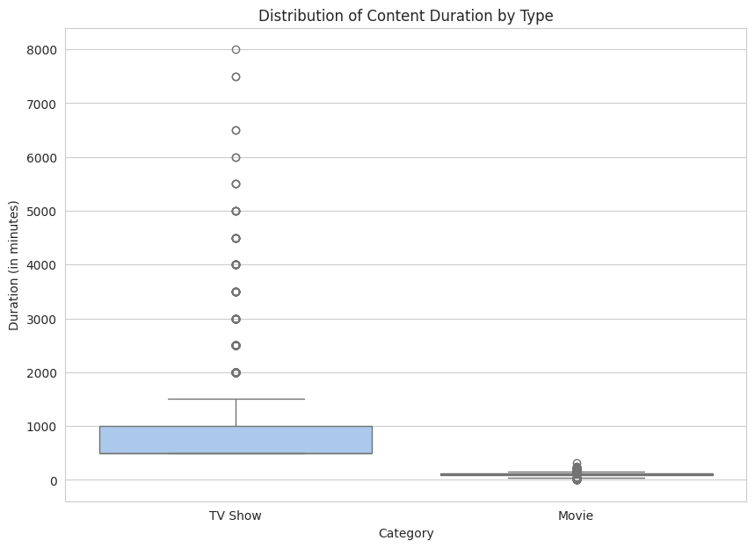
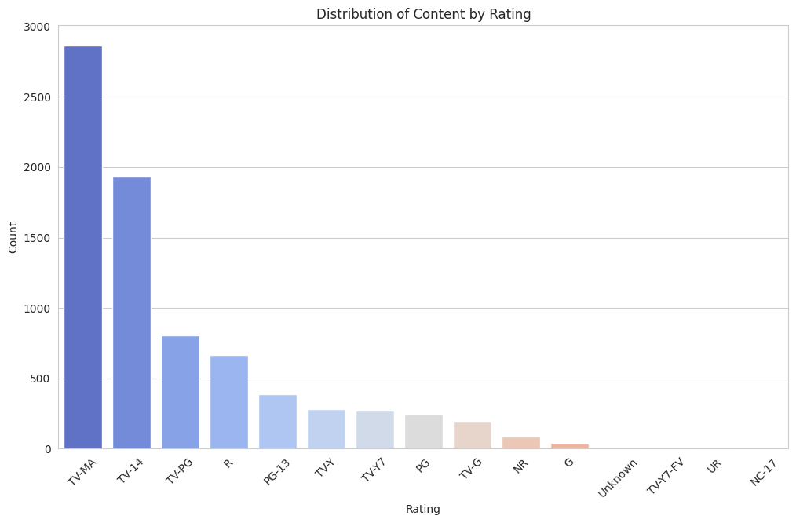
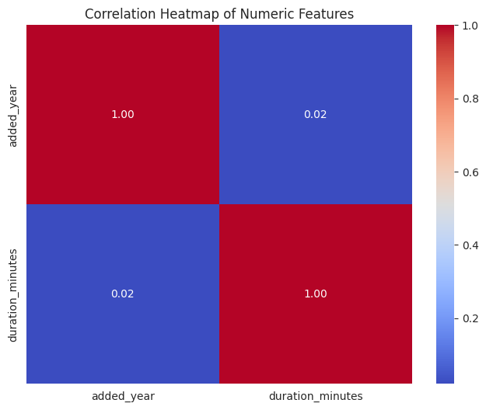
RESULTS4

Slide 11
GitHub repository
https://github.com/git-tarik/VOIS_AICTE_Oct2025_MajorProject_Md_Tarik_Anvar

Slide 12

Getting started with Basics of Python Certificate
[Paste your Certificate Here]

Slide 13
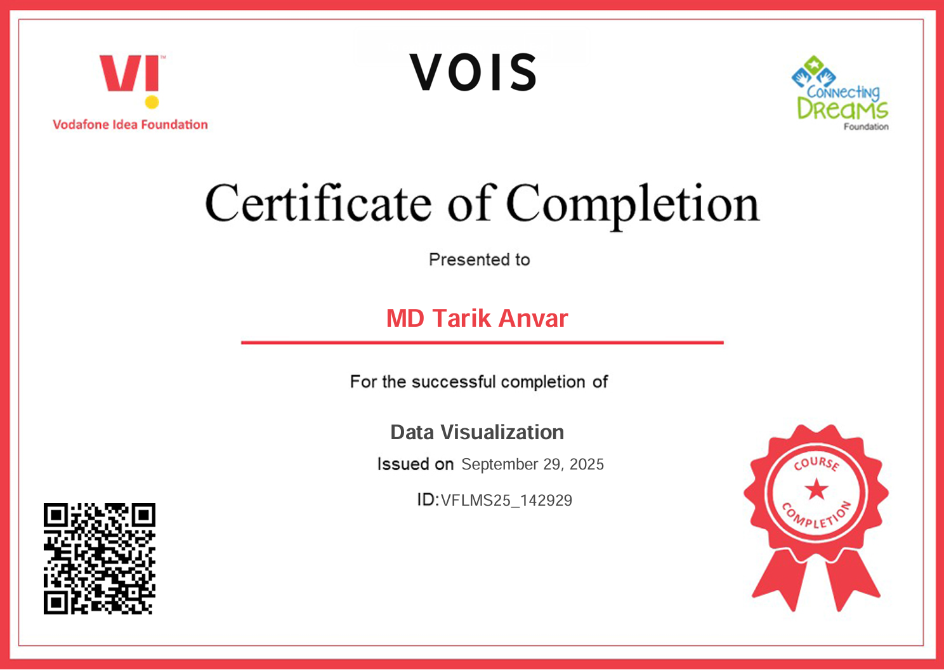
Data Visualization Certificate
[Paste your Certificate Here]

Slide 14
Thank you
.
.

